Slide 1
Marriages
Vraj desai

Slide 2
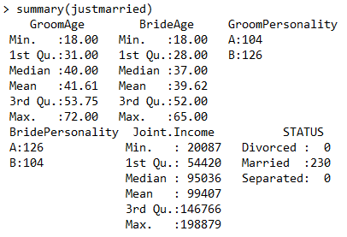
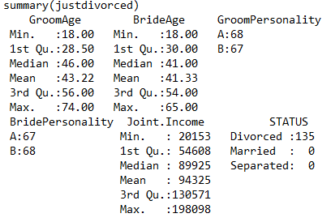
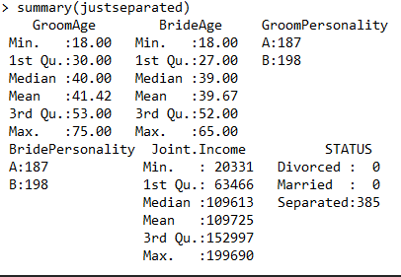
Summaries by Status

Slide 3
Where to start?
As a basic guide and with intuition of relationships, the older the ages of the couple, the higher the chance of a divorce or separation. More time passed = more problems
In addition, if the personality types are different, there is a higher chance for a divorce, marriage, or separation…so it does not play a major factor
Looked at a random sample of 20 marriages and this held true over 80% of the time
Joint Income is a major factor that is very unpredictable….will find out soon enough

Slide 4
Personality Evidence – Same or different. Doesn’t matter!

Slide 5
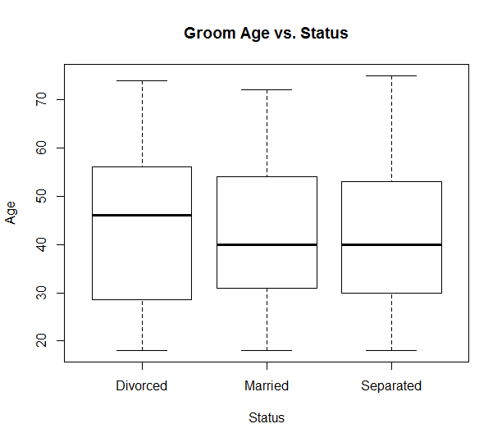
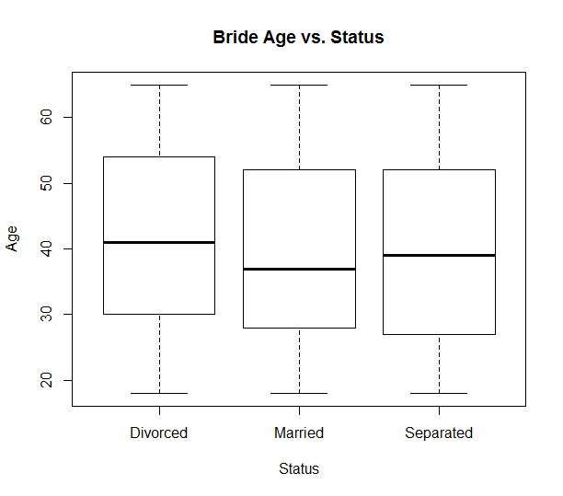
Age Benchmarking Evidence
Divorce: Largest range by age for both genders
Males can range from 28 to 56
Females can range from 28 to 54
Married: Males & Females both generally stay married till 52
Separation: Upper quartile is shortest out all three status of around 51

Slide 6
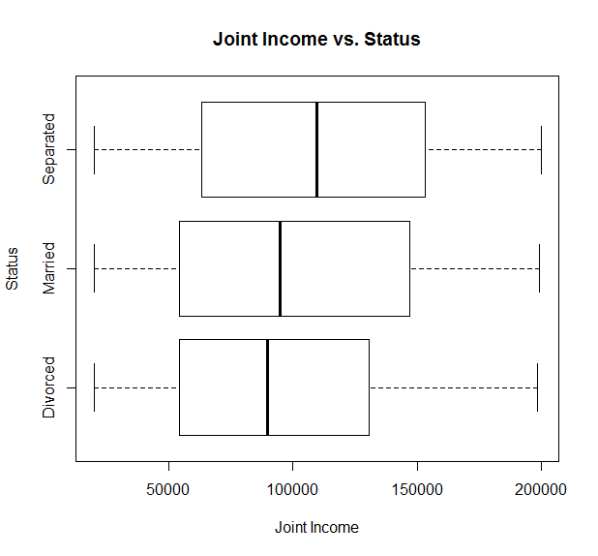
More money, more problems?
Generally, the more money a couple makes together, the higher chance there will be a separation or a marriage still
Lower incomes lead to the most divorces

Slide 7
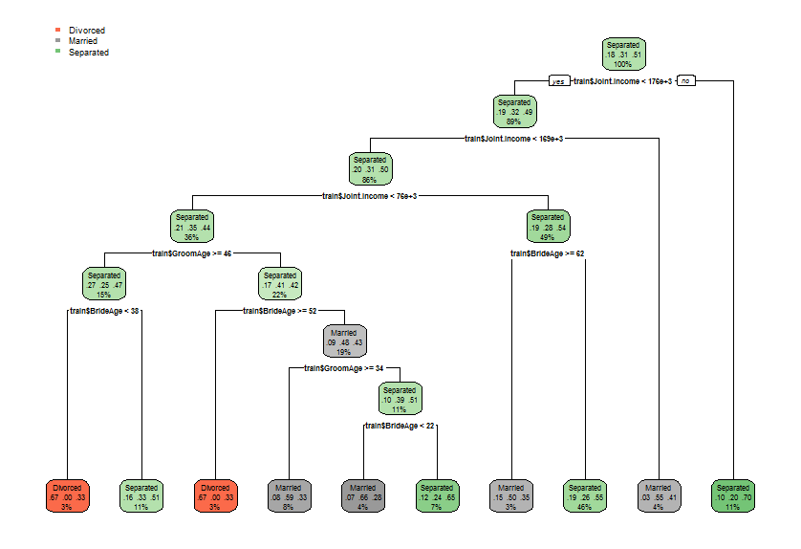
Rpart Plot

Slide 8
Prediction & Cross Validation
From what I saw through plots, I found that age and money are the major reasons for a couple’s current status
Found that money was the primary indicator of a couple’s situation
After that, Bride Age and Groom Age are important
Personality is not important because equally similar personality's work and do not work
Cross Validation
CrossValidation::cross_validate(Marriage_training, tree, 2, 0.8)
accuracy_subset accuracy_all
1 0.3866667 0.4266667
2 0.4733333 0.5933333
Numbers are close to one another so there is a small variance
Did not want to overfit the data any further

Slide 9
Conclusion
Marriages are hard to predict as there are many factors that will affect the current situation of a couple in the long run
Too many factors that it is based off of and these few are not enough
Kids are a major factor that should have been included into whether couples remain together

